Slide 1
CONVOLUTIONAL NEURAL NETWORK
Subject: Advances in Data Sciences

Slide 2
What are CNNs
Convolutional Neural network is a type of feed forward artificial neural network in which connectivity pattern between neurons is inspired by the organization of animal visual cortex.

Slide 3
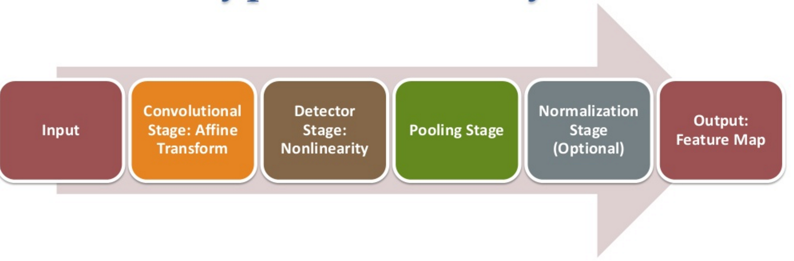
Typical CNN layer

Slide 4
4 Principle Terms of CNN
Local Receptive field: a window on the input of pixels
Feature Maps: mapping from input to hidden layers
Shared Weights: positive or negatives
Pooling: simplifying the information from the feature maps

Slide 5
Architecture of CNN
CNN is a stack of distinct layers that transform the input volume into an output volume through a differential function.
The layers of CNN are
1. Convolutional layer
2.Pooling Layer
3. Relu Layer
4.Fully Connected Layer
5.Loss layer

Slide 6
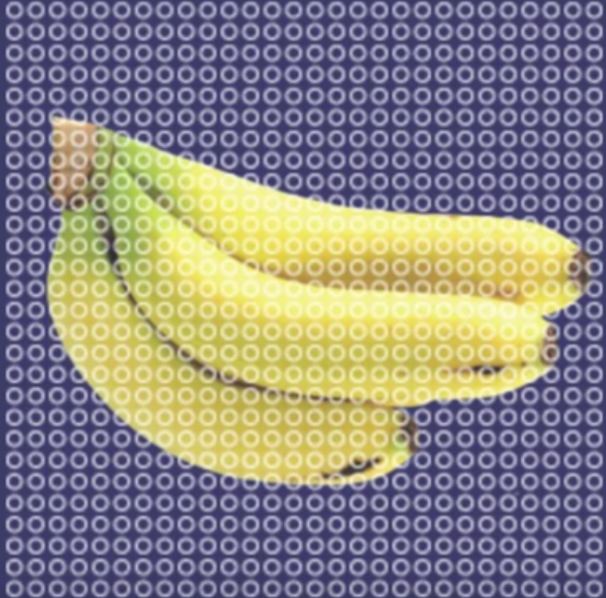
Working of CNN
Consider picture of Banana divided in terms of neurons rather than pixels.

Slide 7
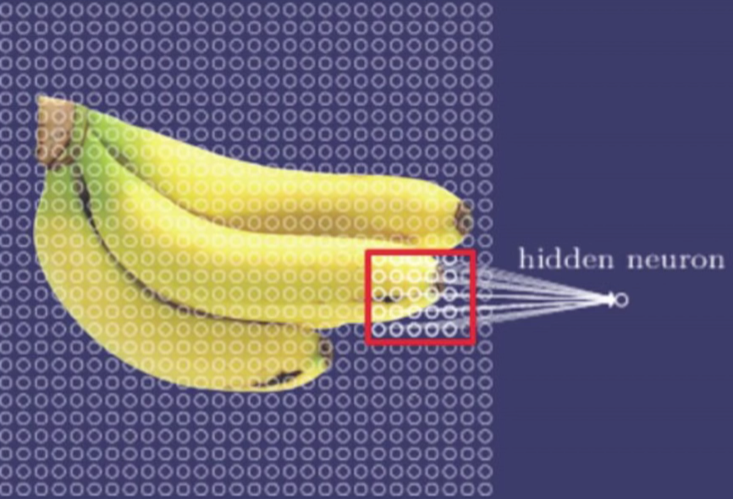
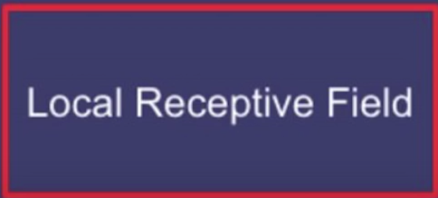

Slide 8
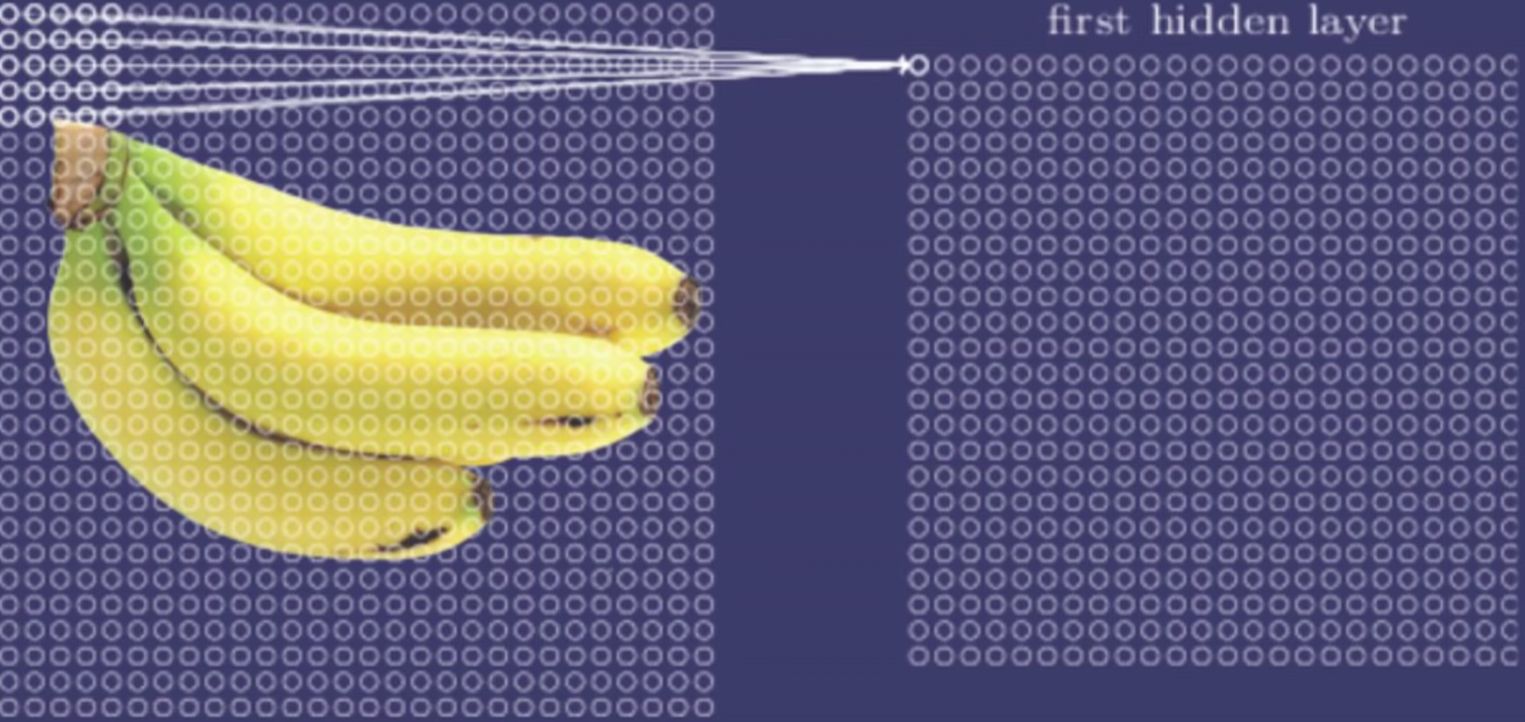
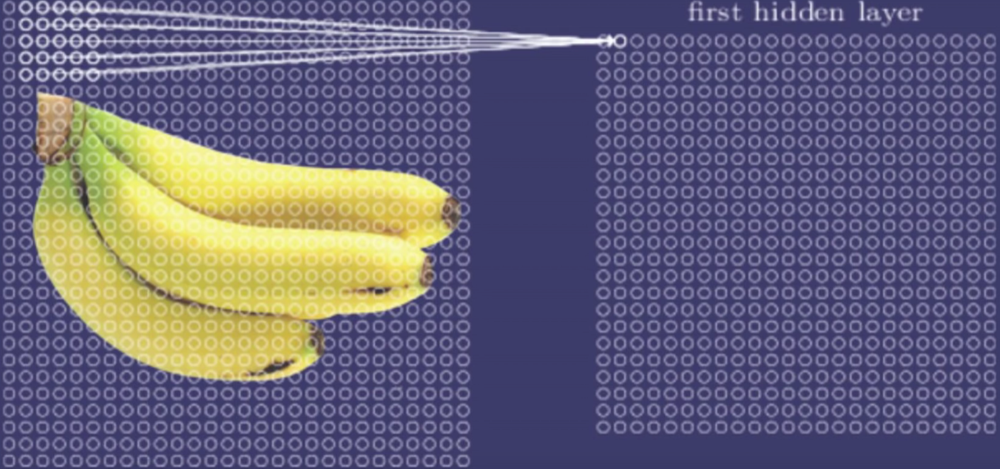
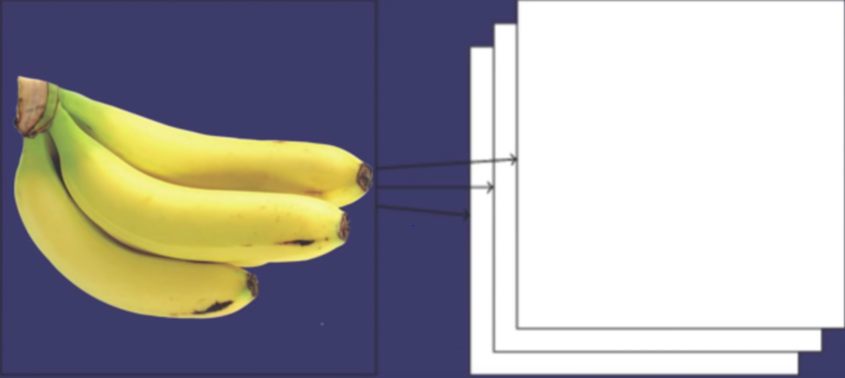

Slide 9
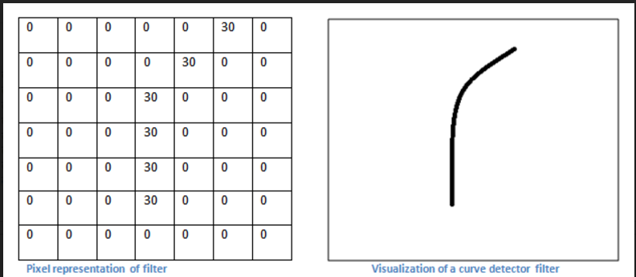
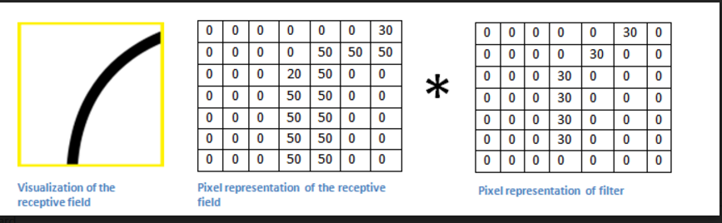

Slide 10
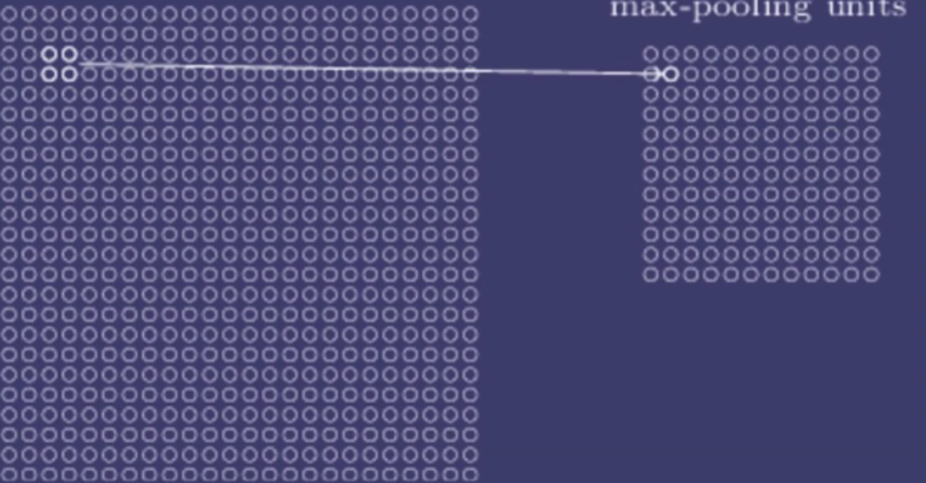
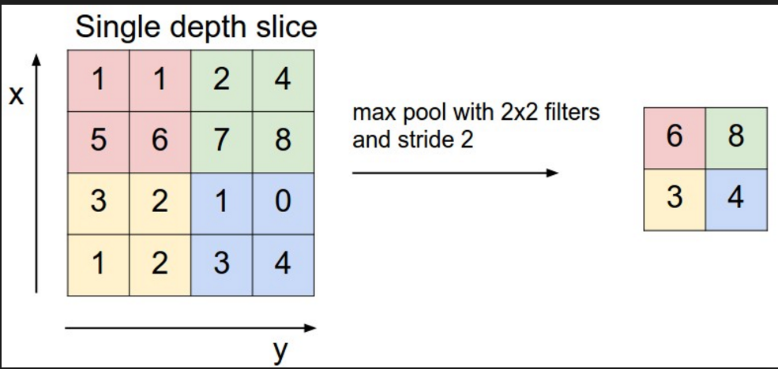

Slide 11
ReLU layer
ReLU is the abbreviation of Rectified Linear Units, the rectifier is an activation function defined as f(x) = max(0,x).
This is a layer of neurons that applies the non-saturating activation function.
It increases the non linear properties of the decision function and of the overall network without affecting the receptive fields of the convolution layer.

Slide 12
Fully connected layer
Finally, after several convolutional and max pooling layers, the high-level reasoning in the neural network is done via fully connected layers.
Neurons in a fully connected layer have full connections to all activations in the previous layer, as seen in regular Neural Networks.
Their activations can hence be computed with a matrix multiplication followed by a bias offset

Slide 13
LOSS LAYER
The loss layer specifies how the network training penalizes the deviation between the predicted and true labels and is normally the last layer in the network.
Various loss functions appropriate for different tasks may be used there.
Softmax loss is used for predicting a single class of K mutually exclusive classes.
Sigmoid cross-entropy loss is used for predicting K independent probability values in [0,1].
Euclidean loss is used for regressing to real-valued labels

Slide 14
Convolutional Neural Networks for Sentence Classification
Requirements
Code is written in Python (2.7) and requires Theano (0.7).
Using the pre-trained word2vec vectors will also
require downloading the binary file from
https://code.google.com/p/word2vec/

Slide 15
Architecture
Pad input sentences so that they are of the same length.
Map words in the padded sentence using word embeddings (which may be either initialized as zero vectors or initialized as word2vec embeddings) to obtain a matrix corresponding to the sentence.
Apply convolution layer with multiple filter widths and feature maps.
Apply max-over-time pooling operation over the feature map.
Concatenate the pooling results from different layers and feed to a fully-connected layer with softmax activation.
Softmax outputs probabilistic distribution over the labels.
Use dropout for regularisation.

Slide 16
Hyperparameters
RELU activation for convolution layers
Filter window of 3, 4, 5 with 100 feature maps each.
Dropout - 0.5
Gradient clipping at 3
Batch size - 50
Adadelta update rule.

Slide 17
Variants
CNN-rand
Randomly initialized word vectors.
CNN-static
Uses pre-trained vectors from word2vec and does not update the word vectors.
CNN-non-static
Same as CNN-static but updates word vectors during training.

Slide 18
Data Preprocessing
To process the raw data, run
python process_data.py path
where path points to the word2vec binary file
(i.e. GoogleNews-vectors-negative300.bin file).
This will create a pickle object called
mr.p in the same folder, which contains the dataset in the right format.

Slide 19
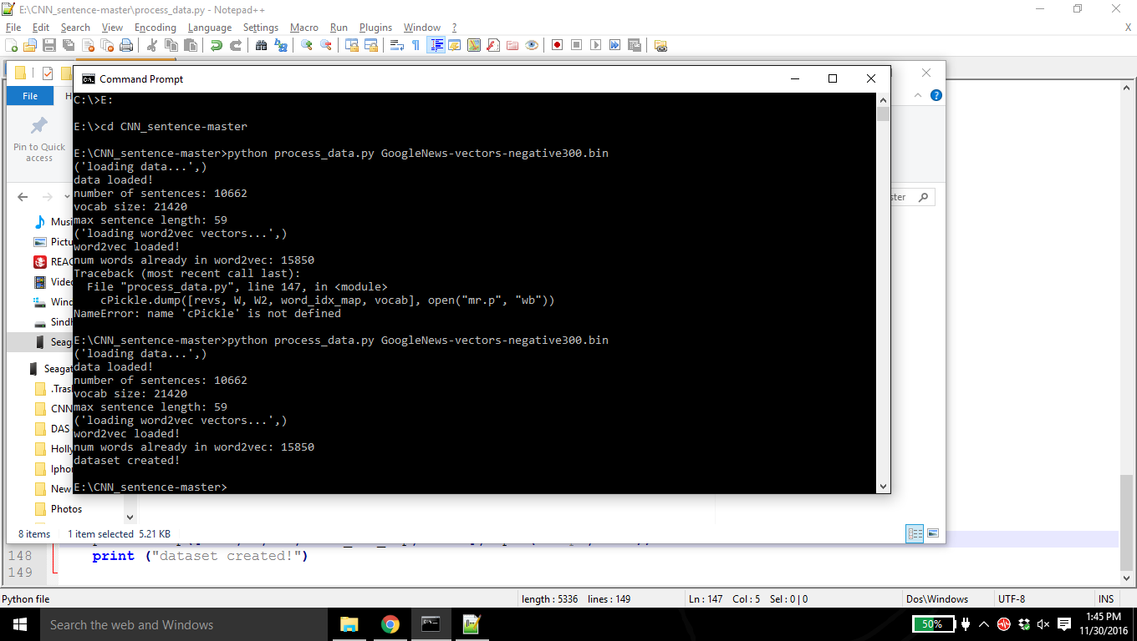
Here a pickle object named mr.p is created

Slide 20
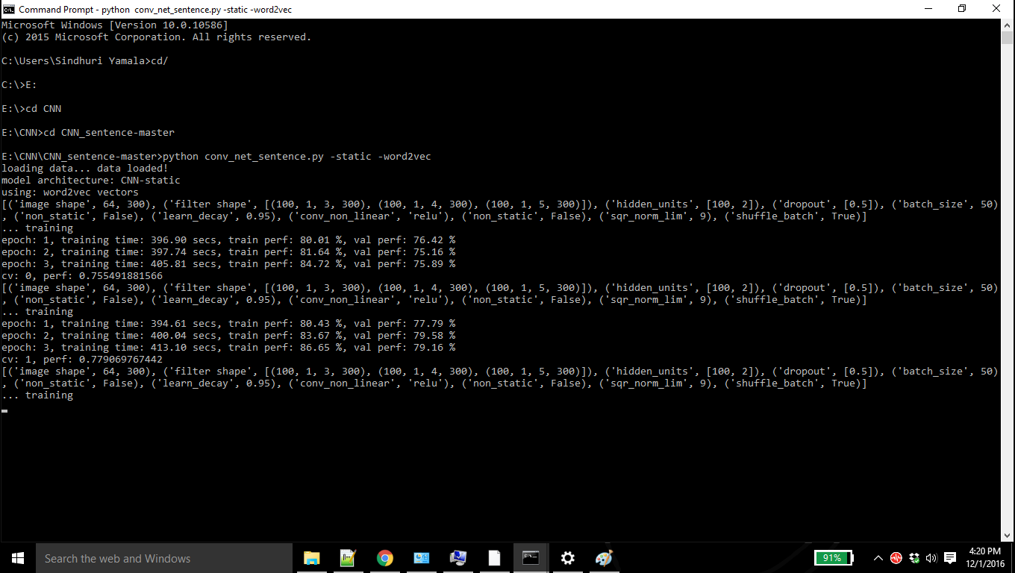

Slide 21
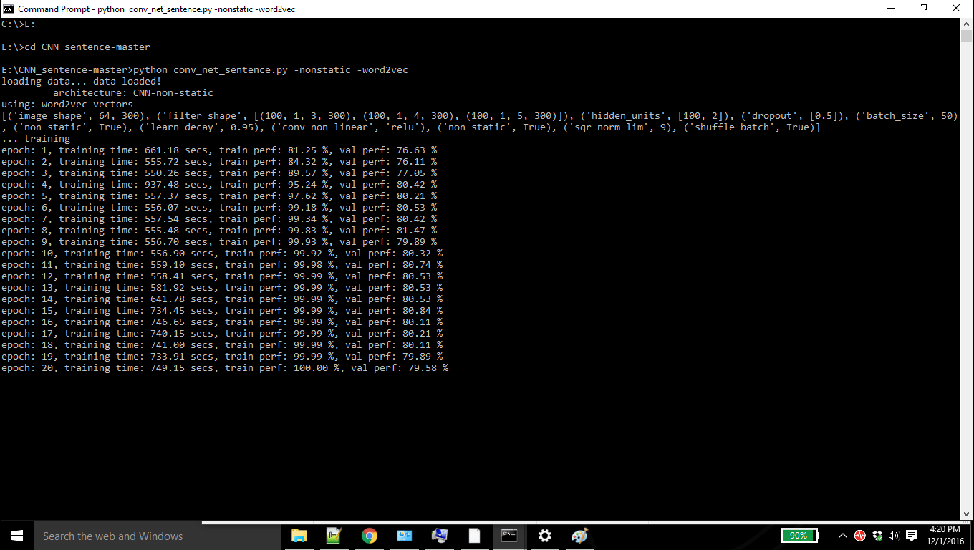

Slide 22
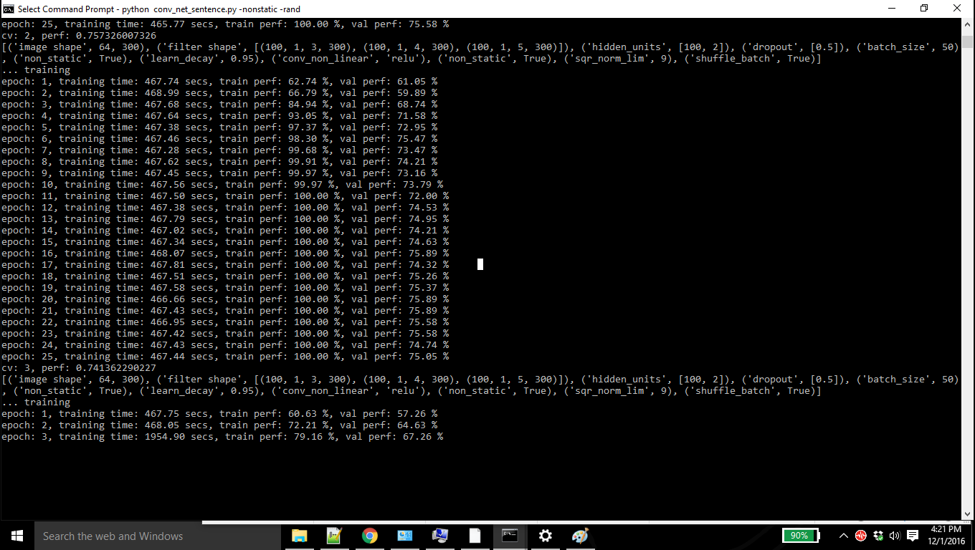

Slide 23
References
https://github.com/yoonkim/CNN_sentence
https://arxiv.org/abs/1408.5882
https://arxiv.org/pdf/1408.5882v2.pdf

Slide 24
Thank You.

